Slide 1
MLOps: Continuous delivery and automation pipelines in machine learning
Pravin Y Pawar
Adapted from
MLOps: Continuous delivery and automation pipelines in machine learning
Cloud Architecture Center | Google Cloud

Slide 2
Data science and ML in Real World
Gaining importance in businesses
Becoming core capabilities for solving complex real-world problems,
transforming industries, and delivering value in all domains
Currently, the ingredients for applying effective ML are :
Large datasets
Inexpensive on-demand compute resources
Specialized accelerators for ML on various cloud platforms
Rapid advances in different ML research fields (such as computer vision, natural language understanding, and recommendations AI systems)
Many businesses are investing in their data science teams and ML capabilities
to develop predictive models that can deliver business value to their users

Slide 3
Real Challenge
Continuously deploy and operate
Data scientists can implement and train an ML model with predictive performance on an offline holdout dataset
Real challenge isn't building an ML model, the challenge is building an integrated ML system and to continuously operate it in production
MLOps is an ML engineering culture and practice that aims at unifying ML system development (Dev) and ML system operation (Ops)
Practicing MLOps means that advocating for automation and monitoring at all steps of ML system construction, including
integration,
testing,
releasing,
deployment and infrastructure management

Slide 4
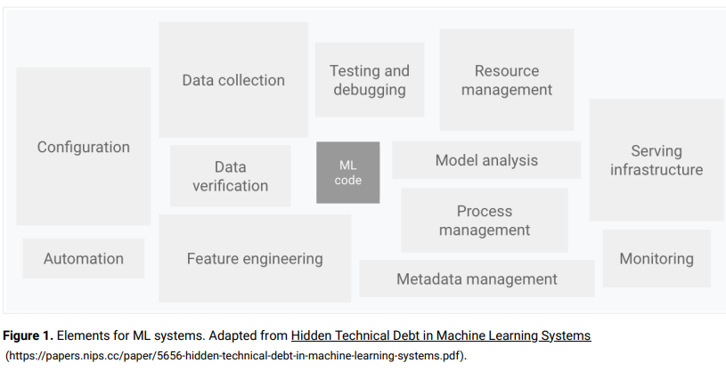
Elements of ML System
Vast and Complex
Can be many pitfalls in operating ML-based systems in production
Some are summarized in Machine Learning: The high-interest credit card of technical debt
Only a small fraction of a real-world ML system is composed of the ML code
Required surrounding elements are vast and complex
Rest of the system is composed of configuration
automation,
data collection,
data verification
testing and debugging,
resource management,
model analysis,
process and metadata management,
serving infrastructure,
and monitoring.
To develop and operate complex systems like these,
need to apply DevOps principles to ML systems (MLOps)

Slide 5
DevOps versus MLOps
DevOps - A popular practice in developing and operating large-scale software systems
Provides benefits such as
shortening the development cycles,
increasing deployment velocity,
and ensures dependable releases
To achieve these benefits, introduces two concepts in the software system development:
Continuous Integration (CI)
Continuous Delivery (CD)
Continuous Integration (CI)
practice of merging all developers' working copies to a shared mainline several times a day
the practice of frequently integrating one's new or changed code with the existing code repository
should occur frequently enough that no intervening window remains between commit and build
such that no errors can arise without developers noticing them and correcting them immediately
Continuous Delivery (CD)
a software engineering approach in which teams produce software in short cycles,
ensuring that the software can be reliably released at any time and, following a pipeline through a "production-like environment", without doing so manually
aims at building, testing, and releasing software with greater speed and frequency
helps reduce the cost, time, and risk of delivering changes by allowing for more incremental updates to applications in production
A straightforward and repeatable deployment process is important for continuous delivery

Slide 6
DevOps versus MLOps(2)
ML systems differ from other software systems - Phases
Team skills
In an ML project, the team usually includes data scientists or ML researchers,
who focus on exploratory data analysis, model development, and experimentation
might not be experienced software engineers who can build production-class services
Development
ML is experimental in nature - need to try different features, algorithms, modeling techniques, and parameter configurations
Challenge is tracking what worked and what didn't, and maintaining reproducibility while maximizing code reusability
Testing
More involved than testing other software systems
In addition to typical unit and integration tests, need data validation, trained model quality evaluation, and model validation
Deployment
In ML systems, deployment isn't as simple as deploying an offline-trained ML model as a prediction service
Required to deploy a multi-step pipeline to automatically retrain and deploy model
pipeline adds complexity and requires to automate steps that are manually done before deployment by data scientists to train and validate new models
Production
ML models can have reduced performance not only due to suboptimal coding, but also due to constantly evolving data profiles
Models can decay in more ways than conventional software systems - need to consider this degradation
Need to track summary statistics of data and monitor the online performance of model
to send notifications or roll back when values deviate from expectations

Slide 7
DevOps versus MLOps(3)
ML systems differ from other software systems - Process
An ML system is a software system
similar practices apply to help guarantee reliably to build and operate ML systems at scale
ML and other software systems are similar wrt
continuous integration of source control, unit testing, integration testing
continuous delivery of the software module or the package
However, in ML, there are a few notable differences:
CI is no longer only about testing and validating code and components
but also testing and validating data, data schemas, and models
CD is no longer about a single software package or a service,
but a system (an ML training pipeline) that should automatically deploy another service (model prediction service)
CT is a new property, unique to ML systems
concerned with automatically retraining and serving the models

Slide 8
Data science steps for ML
Steps can be completed manually or can be completed by an automatic pipeline
Data extraction
select and integrate the relevant data from various data sources for the ML task.
Data analysis
perform exploratory data analysis
Data preparation
prepare date for the ML task - involves data cleaning, data transformations splitting and feature engineering
Model training
implement different algorithms with the prepared data to train various ML models
Model evaluation
evaluate on a holdout test set to assess the model quality
Model validation
confirm whether model is adequate for deployment — predictive performance is better than a certain baseline
Model serving
deploy to a target environment to serve predictions
Model monitoring
monitor models predictive performance to potentially invoke a new iteration in the ML process

Slide 9
Maturity of the ML process
MLOps levels
The level of automation of steps defines the maturity of the ML process
reflects the velocity of training new models given new data or training new models given new implementations
Three levels of MLOps
starting from the most common level, which involves no automation, up to automating both ML and CI/CD pipelines
MLOps level 0: Manual process
MLOps level 1: ML pipeline automation
MLOps level 2: CI/CD pipeline automation

Slide 10
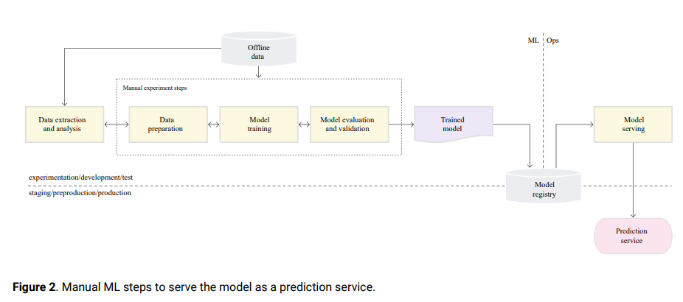
MLOps level 0: Manual process
Data scientists and ML researchers builds state-of-the-art models,
but their process for building and deploying ML models is entirely manual

Slide 11
MLOps level 0: Manual process(2)
Characteristics
Manual, script-driven, and interactive process
Every step is manual, including data analysis, data preparation, model training, and validation
Requires manual execution of each step, and manual transition from one step to another
usually driven by experimental code that is written and executed in notebooks by data scientist interactively, until a workable model is produced
Disconnection between ML and operations
Separates data scientists who create the model and engineers who serve the model as a prediction service
Data scientists hand over a trained model as an artifact to the engineering team to deploy on their API infrastructure
can include putting the trained model in a storage location, checking the model object into a code repository, or uploading it to a models registry
Engineers who deploy the model need to make the required features available in production for low-latency serving
can lead to training-serving skew
Infrequent release iterations
Assumes that data science team manages a few models that don't change frequently

Slide 12
MLOps level 0: Manual process(3)
Characteristics(2)
No CI
Because few implementation changes are assumed, CI is ignored
Usually, testing the code is part of the notebooks or script execution
Scripts and notebooks that implement the experiment steps are source controlled
produce artifacts such as trained models, evaluation metrics, and visualizations
No CD
Because there aren't frequent model version deployments, CD isn't considered
Deployment refers to the prediction service
Concerned only with deploying the trained model as a prediction service
(for example, a microservice with a REST API)
Lack of active performance monitoring
Doesn't track or log the model predictions and actions, which are required in order to detect model performance degradation and other model behavioral drifts

Slide 13
MLOps level 0: Manual process(4)
Challenges
Common in many businesses that are beginning to apply ML to their use cases
manual, data-scientist driven process might be sufficient when models are rarely changed or trained
in practice, models often break when they are deployed in the real world
To address these challenges and to maintain model's accuracy in production, requires to:
Actively monitor the quality of model in production
to detect performance degradation and model staleness
acts as a cue to a new experimentation iteration and (manual) retraining of the model on new data
Frequently retrain production models
need to retrain model with the most recent data - to capture the evolving and emerging patterns
Continuously experiment with new implementations to produce the model
To harness the latest ideas and advances in technology
To try out new implementations such as feature engineering, model architecture, and hyper parameters
To address the challenges of this manual process, MLOps practices for CI/CD and CT are helpful!

Slide 14
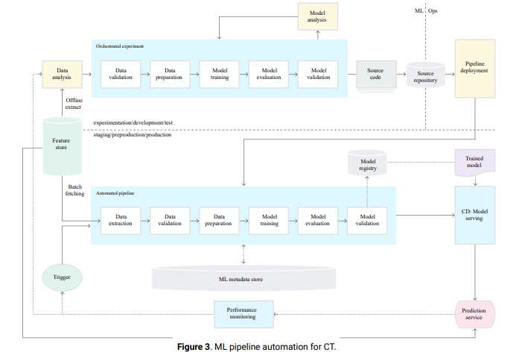
MLOps level 1: ML pipeline automation
Aim to perform continuous training of the model by automating the ML pipeline

Slide 15
MLOps level 1: ML pipeline automation(2)
Characteristics
Rapid experiment
Steps of the ML experiment are orchestrated
Transition between steps is automated, which leads to rapid iteration of experiments and better readiness to move the whole pipeline to production
CT of the model in production
Model is automatically trained in production using fresh data based on live pipeline triggers
Experimental-operational symmetry
The pipeline implementation that is used in the development or experiment environment is used in the preproduction and production environment
key aspect of MLOps practice for unifying DevOps!
Continuous delivery of models
ML pipeline in production continuously delivers prediction services to new models that are trained on new data
The model deployment step, which serves the trained and validated model as a prediction service for online predictions, is automated

Slide 16
MLOps level 1: ML pipeline automation(3)
Characteristics(2)
Modularized code for components and pipelines
To construct ML pipelines, components need to be reusable, composable, and potentially shareable across ML pipelines
Source code for components must be modularized
In addition, components should ideally be containerized to do the following:
Decouple the execution environment from the custom code runtime
Make code reproducible between development and production environments
Isolate each component in the pipeline
Pipeline deployment
In level 0, a trained model is deployed as a prediction service to production
In level 1, a whole training pipeline is deployed
which automatically and recurrently runs to serve the trained model as the prediction service

Slide 17
MLOps level 1: ML pipeline automation(4)
Data validation
When ML pipeline is deployed to production, one or more of the triggers executes the pipeline
Pipeline expects new, live data to produce a new model version that is trained on the new data
Automated data validation and model validation steps are required in the production pipeline
Data validation
Required before model training to decide whether to retrain the model or stop the execution of the pipeline
automatically make a decision if the following was identified by the pipeline
Data schema skews
presence of anomalies in the input data, which means that the downstream pipeline steps, including data processing and model training, receives data that doesn't comply with the expected schema
should stop the pipeline so the data science team can investigate
include receiving unexpected features, not receiving all the expected features, or receiving features with unexpected values
Data values skews
significant changes in the statistical properties of data, which means that data patterns are changing
need to trigger a retraining of the model to capture these changes

Slide 18
MLOps level 1: ML pipeline automation(5)
Model validation
Model validation
Occurs after successfully train the model given the new data to evaluate and validate the model before it's promoted to production
Consists of
Producing evaluation metric values using the trained model on a test dataset to assess the model's predictive quality
Comparing the evaluation metric values produced by newly trained model to the current model,
Making sure that the performance of the model is consistent on various segments of the data
Making sure to test model for deployment, including infrastructure compatibility and consistency with the prediction service API
In addition to offline model validation, a newly deployed model undergoes online model validation
in a canary deployment or an A/B testing setup — before it serves prediction for the online traffic

Slide 19
MLOps level 1: ML pipeline automation(6)
Feature store
An optional additional component - centralized repository to standardize the definition, storage, and access of features for training and serving
Provide an API
for both high-throughput batch serving and low-latency real-time serving for the feature values
to support both training and serving workloads
Helps data scientists to:
Discover and reuse available feature sets for their entities, instead of re-creating the same or similar ones
Avoid having similar features that have different definitions by maintaining features and their related metadata
Serve up-to-date feature values from the feature store
Avoid training-serving skew by using the feature store as the data source for experimentation, continuous
training, and online serving
This approach makes sure that the features used for training are the same ones used during serving:
For experimentation, data scientists can get an offline extract from the feature store to run their experiments.
For continuous training, the automated ML training pipeline can fetch a batch of the up-to-date feature values of the
dataset that are used for the training task.
For online prediction, the prediction service can fetch in a batch of the feature values related to the requested entity,
such as customer demographic features, product features, and current session aggregation features

Slide 20
MLOps level 1: ML pipeline automation(7)
Metadata management
Information about each execution of the ML pipeline is recorded in order to help
with data and artifacts lineage, reproducibility, and comparisons
to debug errors and anomalies
Each time pipeline is executed, the ML metadata store records the following metadata:
The pipeline and component versions that were executed
The start and end date, time, and how long the pipeline took to complete each of the steps
The executor of the pipeline
The parameter arguments that were passed to the pipeline
The pointers to the artifacts produced by each step of the pipeline
location of prepared data, validation anomalies, computed statistics, and extracted vocabulary from the categorical features
A pointer to the previous trained model
if needs to roll back to a previous model version
if needs to produce evaluation metrics for a previous model version when the pipeline is given new test data during the
model validation step
The model evaluation metrics produced during the model evaluation step
for both the training and the testing sets
helps to compare the performance of a newly trained model to the recorded performance of the previous model

Slide 21
MLOps level 1: ML pipeline automation(8)
ML pipeline triggers
Can automate the ML production pipelines to retrain the models with new data, depending on use case:
On demand
Ad-hoc manual execution of the pipeline.
On a schedule
New, labelled data is systematically available for the ML system on a daily, weekly, or monthly basis
Retraining frequency also depends on how frequently the data patterns change, and how expensive it is to retrain models
On availability of new training data
New data is available on an ad-hoc basis when new data is collected and made available in the source databases
On model performance degradation
The model is retrained when there is noticeable performance degradation
On significant changes in the data distributions (concept drift)
notice significant changes on the data distributions of the features that are used to perform the prediction
changes suggest that model has gone stale, and that needs to be retrained on fresh data

Slide 22
MLOps level 1: ML pipeline automation(9)
Challenges
Suitable when need deploy new models based on new data, rather than based on new ML ideas
New implementations of the pipeline aren't frequently deployed
Managing only a few pipelines
Manually test the pipeline and its components
When need to try new ML ideas and rapidly deploy new implementations of the ML components
Need to manage many ML pipelines in production
Need a CI/CD setup to automate the build, test, and deployment of ML pipelines

Slide 23
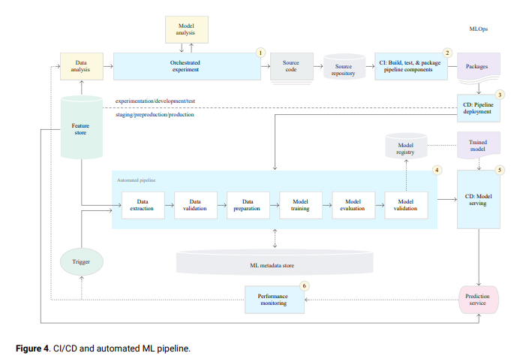
MLOps level 2: CI/CD pipeline automation
Implementation of the ML pipeline using CI/CD

Slide 24
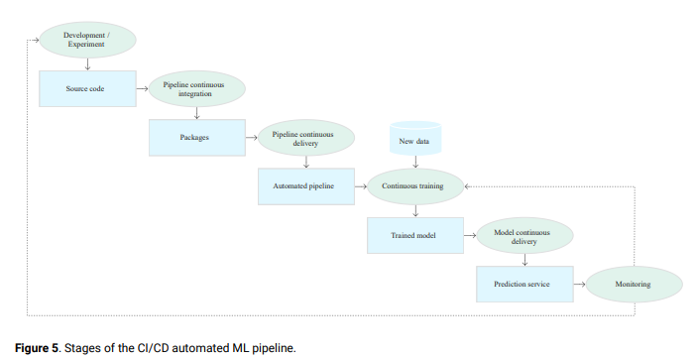
MLOps level 2: CI/CD pipeline automation(2)
Stages of the ML CI/CD automation pipeline

Slide 25
MLOps level 2: CI/CD pipeline automation(3)
Stages of the ML CI/CD automation pipeline(2)
Development and experimentation
Iteratively try out new ML algorithms and new modeling where the experiment steps are orchestrated
Output - the source code of the ML pipeline steps that are then pushed to a source repository
Pipeline continuous integration
Build source code and run various tests
Outputs - pipeline components (packages, executables, and artifacts) to be deployed in a later stage
Pipeline continuous delivery
Deploy the artifacts produced by the CI stage to the target environment
Output - a deployed pipeline with the new implementation of the model
Automated triggering
The pipeline is automatically executed in production based on a schedule or in response to a trigger
Output - a trained model that is pushed to the model registry
Model continuous delivery
Serve the trained model as a prediction service for the predictions
Output - a deployed model prediction service
Monitoring
Collect statistics on the model performance based on live data
Output - a trigger to execute the pipeline or to execute a new experiment cycle
The data analysis step is still a manual process for data scientists before the pipeline starts a new iteration of the experiment
The model analysis step is also a manual process

Slide 26
MLOps level 2: CI/CD pipeline automation(4)
Continuous integration
When new code is committed or pushed to the source code repository
the pipeline and its components are built, tested, and packaged
CI process can include the following tests:
Unit testing feature engineering logic
Unit testing the different methods implemented in model
a function that accepts a categorical data column and encode the function as a one-hot feature
Testing model training doesn't produce NaN values due to dividing by zero or manipulating small or large values
Testing that each component in the pipeline produces the expected artifacts
Testing integration between pipeline components

Slide 27
MLOps level 2: CI/CD pipeline automation(5)
Continuous delivery
System continuously delivers new pipeline implementations to the target environment
that in turn delivers prediction services of the newly trained model.
Rapid and reliable continuous delivery of pipelines and models depend on
Verifying the compatibility of the model with the target infrastructure before model is deployed
need to verify that the packages that are required by the model are installed in the serving environment
whether the memory, compute, and accelerator resources that are available
Testing the prediction service by calling the service API with the expected inputs
making sure that you get the response that you expect
captures problems that might occur when you update the model version and it expects a different input
Testing prediction service performance, which involves load testing the service
to capture metrics such as queries per seconds (QPS) and model latency
Validating the data either for retraining or batch prediction
Verifying that models meet the predictive performance targets before they are deployed
Automated deployment to a test environment - triggered by pushing code to the development branch
Semi-automated deployment to a pre-production environment - triggered by merging code to the main branch after reviewers approve the changes
Manual deployment to a production environment after several successful runs of the pipeline on the pre-production environment

Slide 28
Summary
Implementing ML in a production environment doesn't only mean deploying model as an API for prediction!
Means deploying an ML pipeline that can automate the retraining and deployment of new models
Setting up a CI/CD system enables to automatically test and deploy new pipeline implementations
Allows coping with rapid changes in data and business environment
Don't have to immediately move all of processes from one level to another
Can gradually implement these practices to help improve the automation of your ML system development and production

Slide 29
Thank You!
In our next session:

